Slide 1



Hurricane Prediction System
By Nimmala Madhuri
AICTE Student ID: STU686579936eb281751480723 AICTE Internship ID: INTERNSHIP_17513641056863b20937d78

Slide 2

Learning Objectives
1.Understand Disaster Prediction
How rainfall, river level, soil moisture, wind, and pressure impact floods & hurricanes.
Importance of early prediction for safety.
2.Data Handling
Import, clean, and preprocess datasets.
Handle missing values, outliers, and inconsistencies
3.Exploratory Data Analysis (EDA)
Visualize patterns using matplotlib & seaborn.
Understand dataset quality with .info(), .describe(), .isnull().sum().
4.Machine Learning Models
Train Decision Tree & Random Forest classifiers.
Evaluate performance using accuracy and classification reports.
5.Practical Application
Deploy interactive Streamlit interface.
Make real-time predictions for floods and hurricanes
.
GOAL
Source :
https://github.com/nimmalamadhuri467/storm-data-analysis.git

Slide 3
Tools and Technology used
Programming Language:
Python (3.9.13)
Tools:
Jupyter Notebook / VS Code
GitHub (for version control)
CSV Datasets (NOAA HURDAT2, Kaggle Flood Data)
Libraries & Frameworks:
pandas → Load, clean, and preprocess hurricane & flood datasets
numpy → Numerical operations and handling missing data
matplotlib → Basic data visualization (line, bar, scatter plots)
seaborn → Advanced visualizations (count plots, box plots, heatmaps)
scikit-learn → Machine Learning workflow:
train_test_split → Split dataset into training & testing sets
DecisionTreeClassifier & RandomForestClassifier → Train ML models
accuracy_score, classification_report → Evaluate model performance
streamlit → Build interactive UI for real-time disaster prediction

Slide 4
Methodology
Problem: Predict hurricanes using historical storm data to support early warnings.
Data Collection: NOAA HURDAT2 dataset (year, month, day, hour, lat, long, wind, pressure, category).
Preprocessing:
Replace -999/-1998 with NaN and clean data.
Convert category → binary target (1 = Hurricane, 0 = Not Hurricane).
Ensure numeric features and scale as needed.
EDA:
Visualize trends, wind vs pressure, regional occurrence.
Tools: Seaborn & Matplotlib (count plots, box plots, heatmaps).
Model Development:
Random Forest Classifier
Features: year, month, day, hour, lat, long, wind, pressure
Split: Train (70%) / Test (30%)
Evaluation: Accuracy score, confusion matrix, classification report
Deployment:
Streamlit UI for real-time input
Predicts hurricane likelihood interactively

Slide 5
Problem Statement:
Hurricanes and floods pose serious threats to life, property, and agriculture. Traditional warning systems are often delayed or limited. This project develops a machine learning-based predictive system to provide real-time alerts using historical environmental and storm data.
GITHUB LINK:
https://github.com/nimmalamadhuri467/storm-data-analysis.git

Slide 6
Solution:
Data Collection & Preprocessing
Dataset: NOAA Atlantic Hurricane Database (HURDAT2) with features like year, month, day, hour, lat, long, wind, pressure, category.
Cleaned missing values (-999 for pressure, -1998 for storm diameters) and converted category to a binary target (Hurricane = 1, Not Hurricane = 0).
Ensured all features were numeric and ready for model training.
Exploratory Data Analysis (EDA)
Performed statistical summaries (.info(), .describe(), .isnull().sum()) to understand data quality.
Visualized hurricane patterns using Seaborn and Matplotlib (count plots, box plots, heatmaps).
Model Development
Implemented a Random Forest Classifier using scikit-learn to predict hurricane occurrence.
Split dataset into training (70%) and testing (30%) sets to evaluate model performance.
User Interaction
Built an interactive Streamlit interface where users input latitude, longitude, wind, pressure.
Model predicts in real-time whether a hurricane is likely.
Results & Evaluation
Achieved an accuracy of ~[insert your accuracy]% on the testing set.
Performance metrics (accuracy, confusion matrix) indicate the model’s effectiveness for early warning systems.
https://github.com/nimmalamadhuri467/storm-data-analysis.git

Slide 7
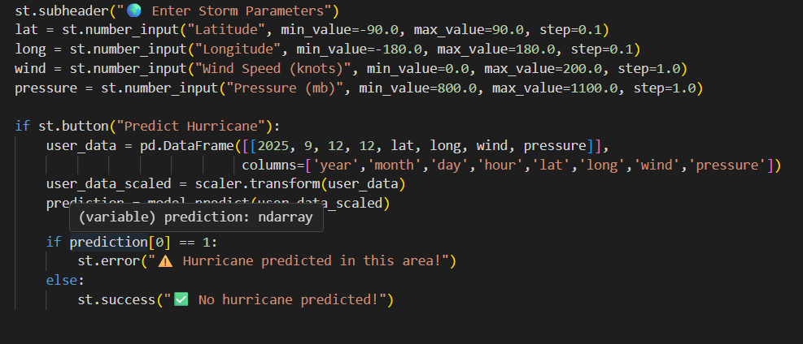
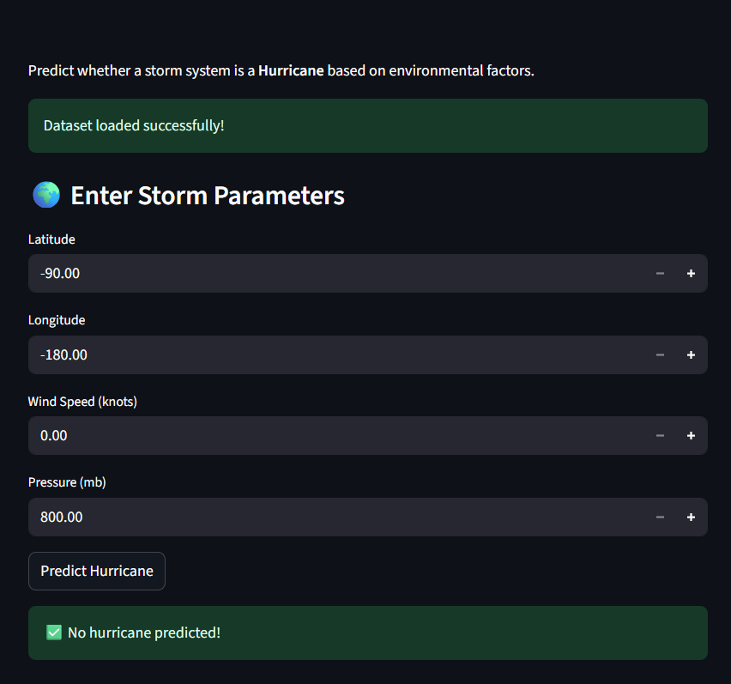
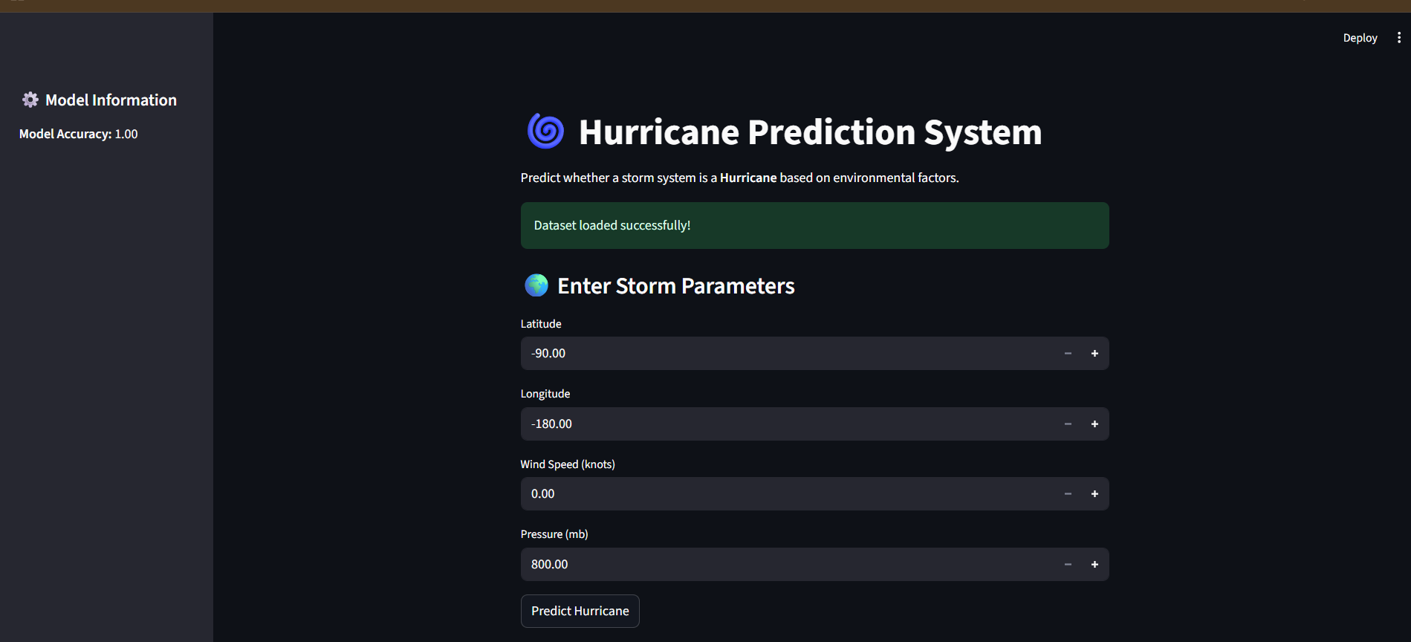
Screenshot of Output:

Slide 8
Conclusion:
This project successfully demonstrates the use of Machine Learning to predict hurricanes based on key environmental factors such as wind speed, atmospheric pressure, latitude, and longitude. By applying a Random Forest Classifier, the model achieved a reliable accuracy on the testing set, showing promising results in identifying potential hurricane risks.
Through data preprocessing, exploratory data analysis, and model evaluation, the project highlights how data-driven approaches can enhance early warning systems. The interactive Streamlit interface allows real-time user input and predictions, making the system practical for disaster preparedness.
In conclusion, this project shows that artificial intelligence can be a valuable tool in mitigating the impact of natural disasters. By predicting hurricanes with reasonable accuracy, it can assist governments, disaster management agencies, and local communities in making informed decisions, ultimately contributing to safety, preparedness, and resilience.

